Slide 1
Time-Lapse Photography
Behind the Magic
By Mark ‘Indy’ Kochte
Howard Astronomical League meeting March 21, 2013

Slide 2
What Is Time-Lapse Photography?
It is the use of a sequence of still images to capture the passage of time, capturing objects/events that would take minutes, days, weeks, or even months to change and replaying them as if they would occur in seconds.
As such, it is a dramatic storytelling tool

Slide 3
What Time-Lapse Photography Isn’t
It is not classical stop-motion photography.
It isn’t slow-motion/high-speed photography.

Slide 4
Time-lapse Technical Nitpick
If you want to be grammatically correct, it’s “time-lapse”, not “timelapse” or “time lapse”

Slide 5
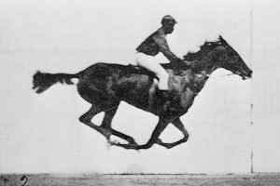
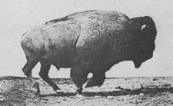
Brief History of Time-lapse Photography
In 1872, Eadweard Muybridge, landscape and war photographer, was hired to settle a bet on whether or not all four of a horse’s hoofs left ground at same time while on a trot.
It took him five years to developed a technique and the equipment that allowed him to quickly capture multiple image frames sequentially
After many trials and errors, in 1878 captured one frame demonstrating conclusively that all four hooves of a horse were fully airborne during a trot.

Slide 6
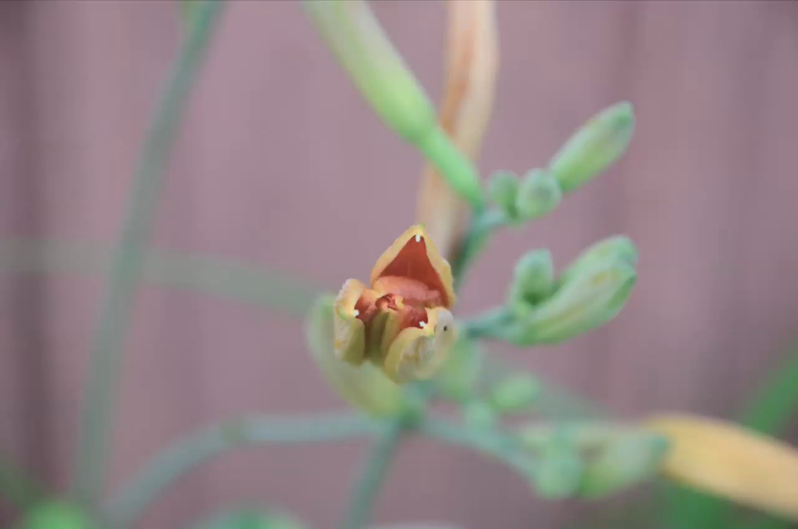
Brief History of Time-lapse Photography
Muybridge continued studying animal and human locomotion with his banks of cameras for the University of Pennsylvania, shooting over 100,000 images in the mid 1880s.
Time-lapse as a separate technique, however, did not appear for another decade
In 1898 German botanist Wilhelm Pfeffer re-imagined Muybridge’s work and created the first time-lapse film of a tulip plant opening. This was the first time one could witness something that happens over a numbingly long period of time occur in just a few seconds.

Slide 7
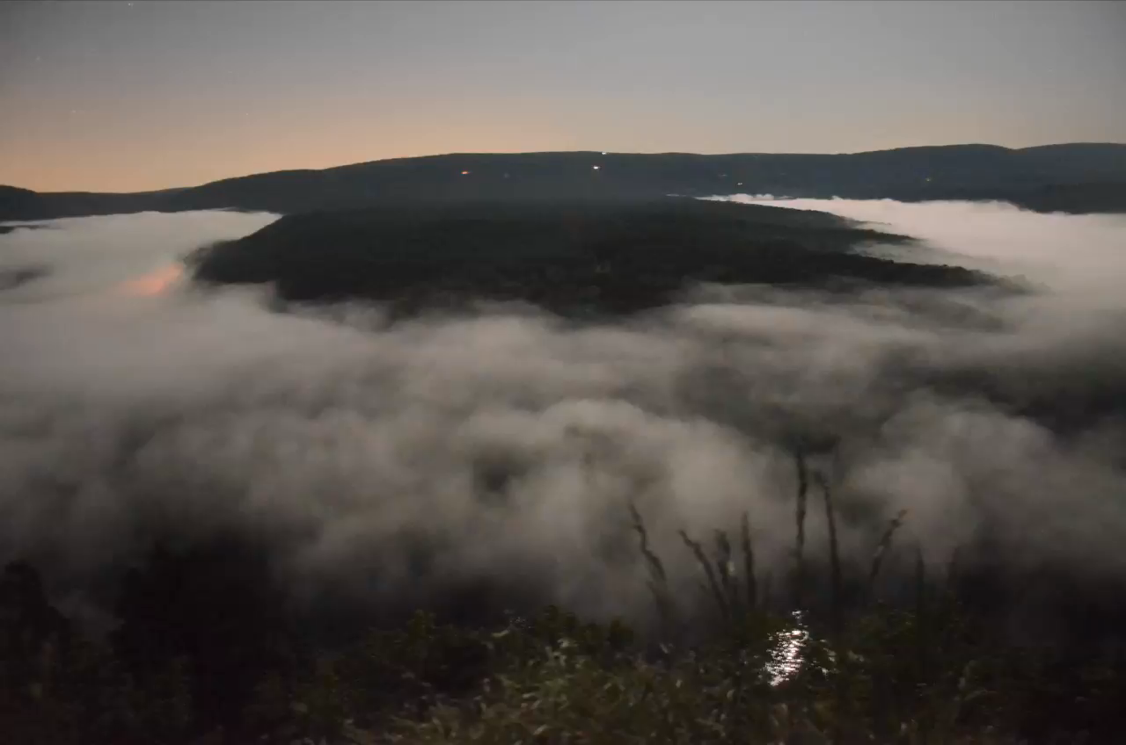
Classic TL Subjects
Clouds, weather
Traffic (car, city, boat, airport activity, etc)
People (individuals, groups, crowds, downtown, beach, climbing, etc)
Flowers (opening, closing)
Rotting fruit
Melting ice, melting snow
Baking (cookies are a favorite, you often see this in commercials)
Demolition/construction
The night sky (stars, Moon, Milky Way, aurora, etc)

Slide 8
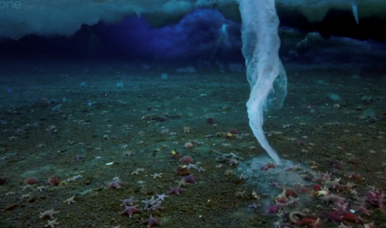
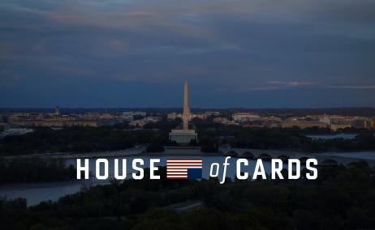
Examples You May Have Seen
Clouds, storms in movies and tv shows – e.g., Discovery Channel’s Planet Earth and Frozen Planet (esp segment ‘Finger of Death’)
Title sequence of series House of Cards
The night sky (esp aurora sequences)

Slide 9
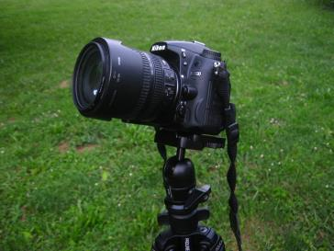
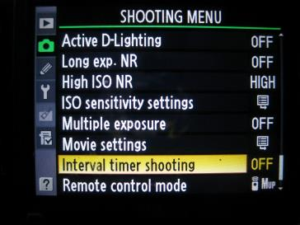
Basic/Minimal Necessities for Time-lapse Photography
Camera
Intervalometer (some cameras have this built in)
Tripod (something heavy-duty, solid, not rickety)
Patience (lots of patience!)
Motivation/Dedication

Slide 10
Camera Considerations
What do you want to do with your camera.
Where do you want to take yourself with your photography (just time-lapse exclusively, or more?).
What is your budget.
What particular features are important in a camera.

Slide 11
Camera Considerations, con’t
Consider shutter wear. Time-lapse will significantly impact the lifespan of a shutter. You can try camerashuttercount.com to see where your camera’s shutter is at. (after one year of time-lapsing my first Nikon D7000 had a shutter count over 97,000)

Slide 12
Composition and Prediction
Composition
Prediction
As with all photography, composition is important.
Foreground objects can enhance – or obscure – a TL activity in the background.
Rule of Thirds applies as usual (and should be broken as needed).
Plan your shots/sequences! Arrive and set up early.
How will or might the TL subject change over the sequence? (very difficult to guess in many cases!)
How fast will the subject change/motion take?
How will the light change during the sequence?

Slide 13
RAW vs JPEG? – The Pros
RAW Pro
JPEG Pro
Significantly smaller (3-10x or more) than RAW files.
Adopted as standard and can be displayed almost immediately pretty much anywhere.
Contains ALL the pixel data for an image; no compression loss.
Allow for easy adjustments in post-processing, and allow syncing settings in batch with no data loss.

Slide 14
RAW vs JPEG? – The Cons
RAW Con
JPEG Con
Files are HUGE. Take up a LOT of space, either on the camera card or on the computer. May need several cards or external hard drives to hold all the files over time.
Formats are proprietary to each manufacturer. Difficult to always be able to display quickly w/out some processing.
Considered a ‘lossy’ format – every time an image is saved, there is compression and data loss.
One-time interpretation of camera data (white balance, exposure setting, etc). Cannot be re-outputted like RAW.

Slide 15
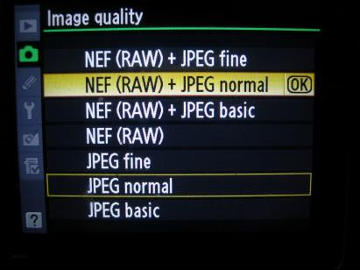
RAW vs JPEG?
JPEG is great for learning on. It also allows you to quickly, within minutes, generate a basic TL sequence to review or show others.
RAW allows for much more flexibility and control in post-processing, to “get things right”. If you have the space, it pays off in the long run.

Slide 16
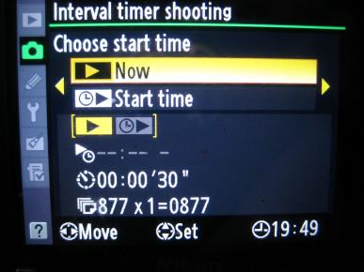
Selecting a TL Interval
No two scenes are alike
No two subjects are alike
Too long an interval = jumpy, stuttery, jerky video
Too short an interval = subject motion changes too slowly

Slide 17
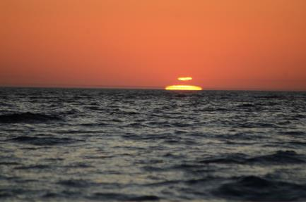
Some Baseline Intervals
1 Second Intervals
1-10 Second Intervals
Moving traffic
Fast moving clouds
Drivelapses (TL sequences from a moving vehicle)
Sunsets & sunrises
Slower moving clouds
Crowds, people
Boats at anchor in harbor
Moon and Sun near horizon
Using a telephoto
Hyper-lapse/walk-lapse/stop motion time-lapse

Slide 18
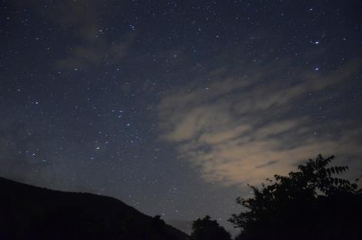
Some Baseline Intervals
15-30 Seconds
Longer
Flowers opening/closing
Fast growing plants (90-120 seconds)
Melting ice
Long-term construction projects (5-15 min)
Moving shadows
Sun across sky
Night sky (astro-lapse)

Slide 19
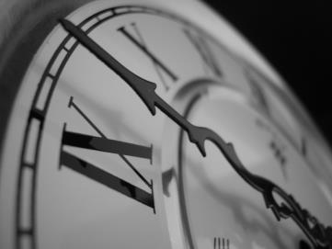
Length of Video Segment
Better to over-shoot than under-shoot. Can always trim back an over-long sequence.
Ideally 8-15 seconds of video is good. Much less, just gets interesting as scene ends. Much more, could be boring after a while.

Slide 20
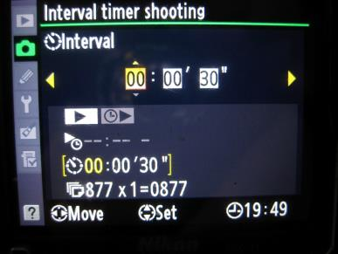
How Many Shots??
Shooting Time Duration Calculation:
(video length) * (frame rate) * (interval) = total camera shooting time
Calculate # frames required
Determine interval between shots
Calculate shooting time

Slide 21
How Many Shots??
Shooting Time Duration Calculation:
(video length) * (frame rate) * (interval) = total camera shooting time
Calculate # frames required
Determine interval between shots
Calculate shooting time
Example: 10 second video, 24 frames/second,
with 5 seconds between shots = 1200 seconds
or 20 minutes of real time shooting.
Astrolapse example: 90 second video, 24 fps,
30 seconds between shots = 64,800 seconds
or 18 hours of real time shooting

Slide 22
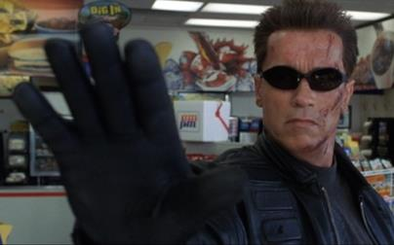
Talk To The Hand
When first setting up, take test shots.
Once happy with the composition, camera position, exposure times, intervalometer values, etc., ‘block’ the lens with your hand or something for the first shot.
This allows you to more easily find the start of a sequence when reviewing sequences in post.
Another method: keep track of the image file timestamps. Good luck ☺

Slide 23
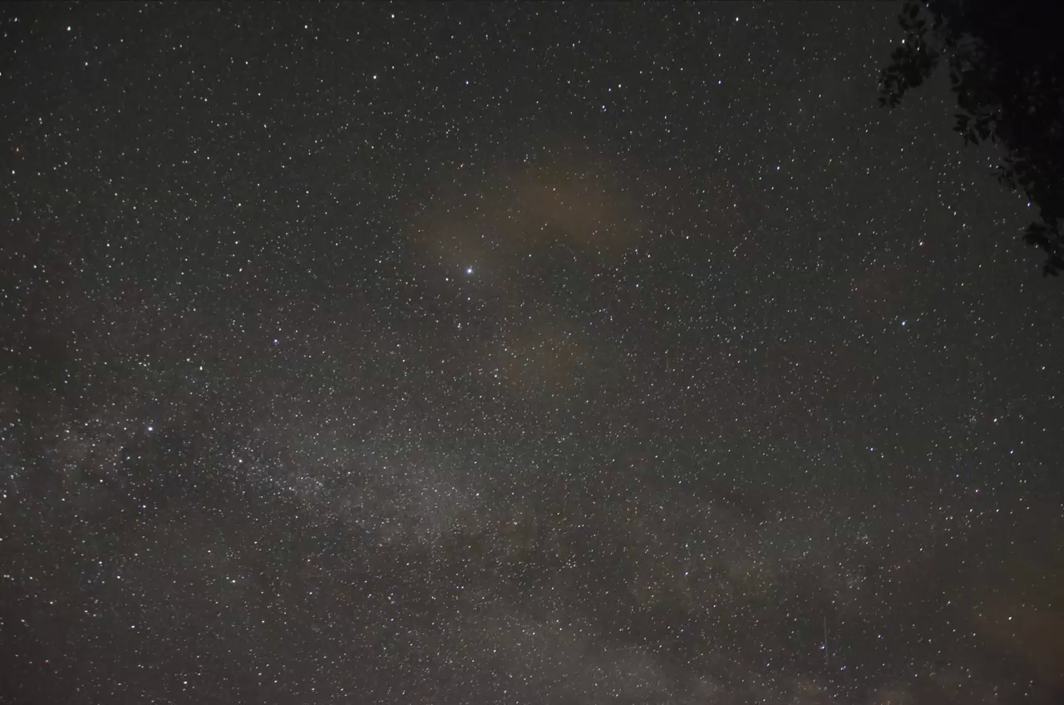
Night Sky TL Photography: Astrolapse
Taking time-lapse sequences of the night sky can be very rewarding, and can be done with minimal additional equipment over daytime time-lapse.
However, time-lapse of the night sky offers a host of other concerns, considerations, and challenges.

Slide 24
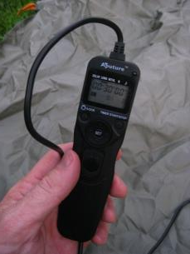
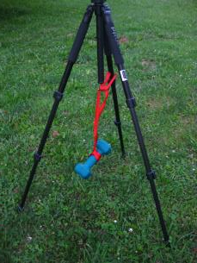
Basic/Minimal Equipment Needed
Camera capable of time exposures
Intervalometer (if not already built into the camera)
Tripod, counterweights if using a dolly
Handwarmers or other dew-prevention mechanisms
More patience
Even more motivation/dedication

Slide 25
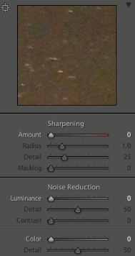
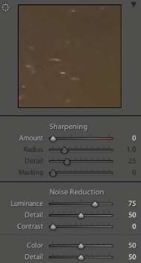
ISO Settings and Noise
Higher ISOs will pick up fainter stars, but…
Higher ISOs generally are more noisy than lower ISO settings. Noise, however, varies from camera to camera, manufacturer to manufacturer for similar ISO levels.
Higher humidity and/or temperature levels will yield noisier images than lower humidity/temperature levels.
Some noise can be corrected/mitigated in post-production.

Slide 26
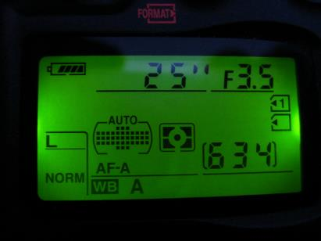
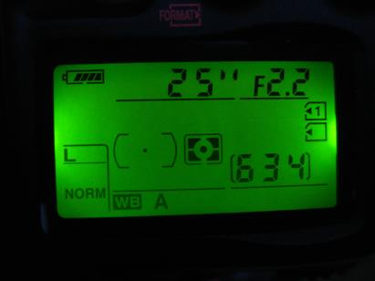
Apertures and Shutter Speeds
Wide apertures allow more light collection in a given time period.
Long shutter speeds allow more light collection over a period of time.

Slide 27
Star Trails and the Rule of 600
Dependent upon focal length of lens.
Exposures can be anywhere from 8 to 30 seconds w/out noticeable streaking.
Formula:
600/(effective lens focal length) = max time (seconds) to shoot w/out trailing.
Effective focal length is lens focal length in mm x crop factor
Nikon’s D7000 has a crop factor of 1.5 – yields 22 second exposures before noticeable trailing occurs with an 18mm lens.

Slide 28
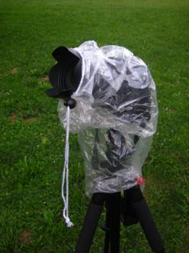
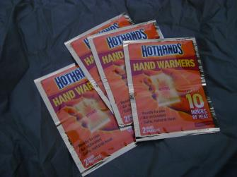
Power and Moisture Protection
Astro-lapse takes place over hours. Make sure your batteries can keep up! Or have an alternate power source for the camera.
Dew, or rain, can put a real damper on your night. Consider an inexpensive ‘rainjacket’, or a plastic bag, for the camera.
Handwarmers strapped to the end of the lens will do wonders to prevent dew build-up in all but the most extreme cases.

Slide 29
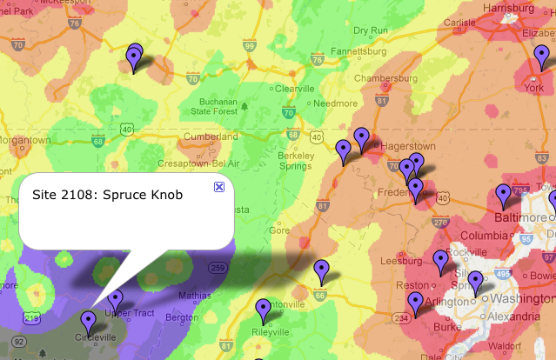
Location, Location, Location http://www.jshine.net/astronomy/dark_sky/
At higher ISO settings, horizon glow from cities 100-200 or more miles
away can be easily picked up by the camera, even if the light domes
look dim to your eye.

Slide 30
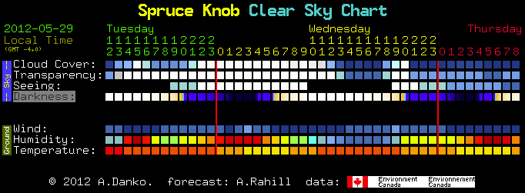
Weather or Not to Shoot…
The Clear Sky Chart home page:
http://cleardarksky.com/csk/

Slide 31
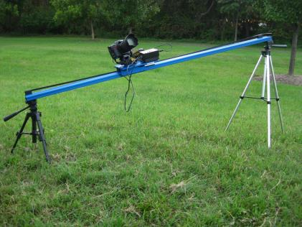
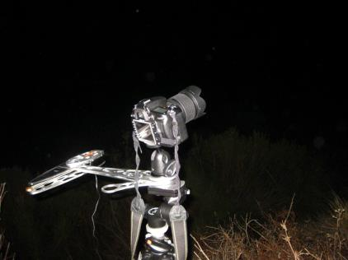
‘Advanced’ Night Sky TL Sequences
Dolly unit (e.g., Dynamic Perception Stage Zero Dolly)
Pan/tilt mechanism (e.g., Celestron “Sky-Watcher”, Astrotrac, or similar)
Batteries! (for dolly, pan/tilt gear, extra for camera)

Slide 32
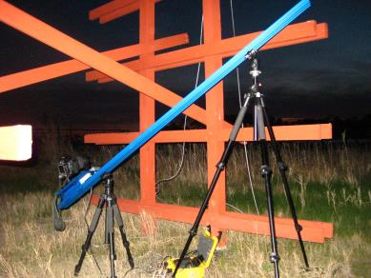
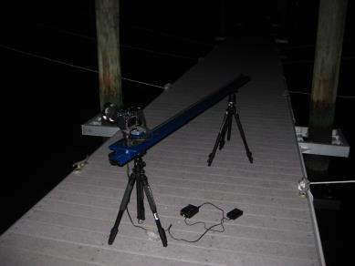
Hyperlapse: put a little motion in your video
Dolly Lengths (variable)
Cart speed (~0.22”-0.35” good ballpark for 10-15 second time-lapse video on a 6’ dolly)
Angle (horizontal/traverse, vertical/climb, in between)
Counterweights for tripods if on uneven ground

Slide 33
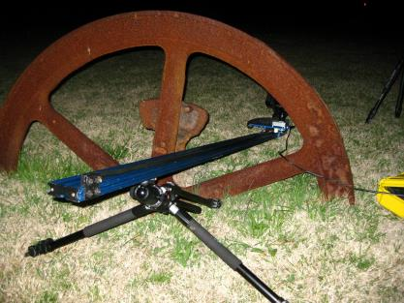
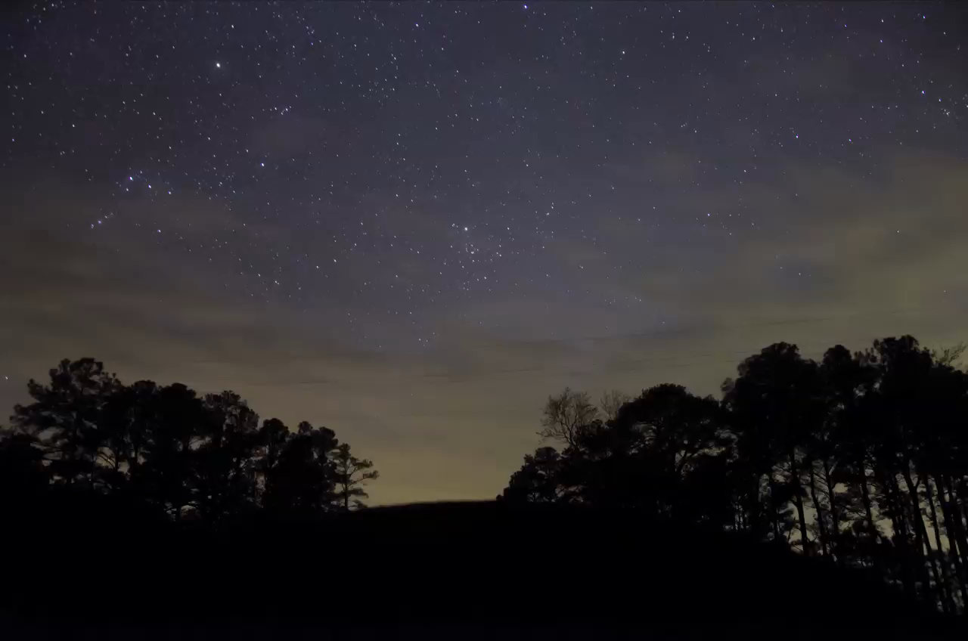
Hyperlapsing
Need some kind of foreground object(s) to work with.
Having a dolly with no foreground objects to also move is kinda pointless.
The closer the foreground object(s), the more effective it/they are in the time-lapse sequence.
Pan/tilt systems can work without foreground objects, but said objects add to the sequence.

Slide 34
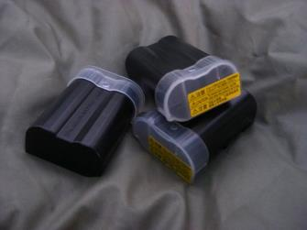
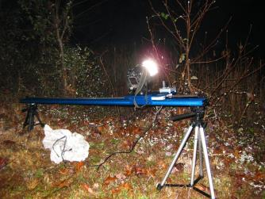
TL Lessons Learned (i.e., Experience Teaches…)
Make sure you have your battery, and/or extra batteries
Make sure all your batteries are fully charged
Make sure you have your tripod(s)
Make sure you have your ‘advanced gear’ together and with you
Make sure you have enough space on your SD card(s)
Make sure SD cards are not locked
Make sure your camera strap is tucked away
Don’t forget handwarmers
Auto-focus – OFF!!
And finally, don’t forget your camera!

Slide 35
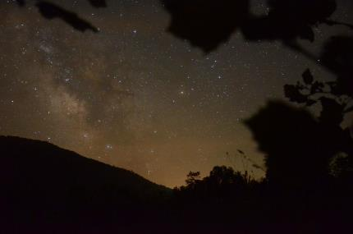
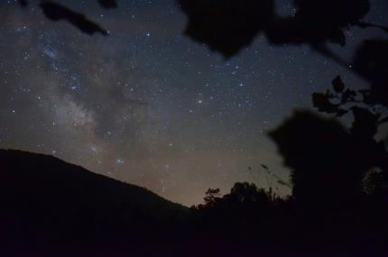
Post Processing Considerations
Brightness/Contrast
White Balance
Noise Reduction
Cropping, resizing
Batch Processing, syncing changes

Slide 36
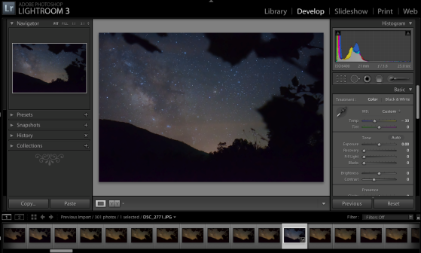
Post Processing Software Options
Lightroom
LRTimelapse
Adobe After Effects
Photoshop
GIMP
batch processing is difficult to achieve
Paintshop Pro
Unsure about batch processing options

Slide 37
You Have Your Photos – Now What?Putting It All Together
Time Lapse Assembler (for Macs; very basic, no transitions, music syncing, etc)
iMovie (Mac) or Windows Movie Maker
Quicktime 7 (Quicktime X is NOT backward compatible!!!)
VirtualDub (Windows)
Adobe Premiere Pro or Elements (expennnsive!)
Final Cut Pro (somewhat expensive)

Slide 38
Music Resources
Vimeo Music Store (~$2/song ave, includes single use license)
Free Music Archive (freemusicarchive.org; licensing varies)
Soundcloud (soundcloud.com; requires registration)
Production Music (freeplaymusic.com; licenses expensive)
Simon Wilkinson (bluemask.com; ~$15 US/song track with single use license)
Musicloops.com (kinda expensive at $10-50, royalty free)
Bands with whom you are friends

Slide 39
Music Resources
Vimeo Music Store (~$2/song ave, includes single use license)
Free Music Archive (freemusicarchive.org; licensing varies)
Soundcloud (soundcloud.com; requires registration)
Production Music (freeplaymusic.com; licenses expensive)
Simon Wilkinson (bluemask.com; ~$15 US/song track with single use license)
Musicloops.com (kinda expensive at $10-50, royalty free)
Bands with whom you are friends

Slide 40
Video Sharing Resources
Youtube - very popular, wide distribution
Vimeo - wide distribution, quality better than youtube but not as popular; for the more ‘discerning’ individual
Flickr - limited distribution
Facebook - limited distribution

Slide 41
Misc Resources
Time-lapse Photography – Ryan Chylinski ($15 pdf download at LearnTimelapse.com)
Timelapse – An Introduction to Still Photographs in Motion – Dave Delnea ($5 pdf download at craftandvision.com - $4 if you use TIME4 before March 23rd, though)
Timescapes Digital Time-lapse forum (forum.timescapes.org/)
Kessler Filmmaker Tools (kesslercrane.com)
Dynamic Perception dollies and controllers (dynamicperception.com)

Slide 42
Online Resources
Facebook Groups – We Love Timelapse and Time-Lapse Photography
LinkedIn group – Time Lapse Photography
Vimeo.com – has a number of time-lapse groups and channels

Slide 43
Inspirational Resources
Randy Halverson’s videos (dakotalapse.com)
Tom Lowe’s Timescapes (timescapes.org)
Norwegian Terje Sorgjerd (vimeo.com/terjes and facebook.com/TSOPhotography)

Slide 44
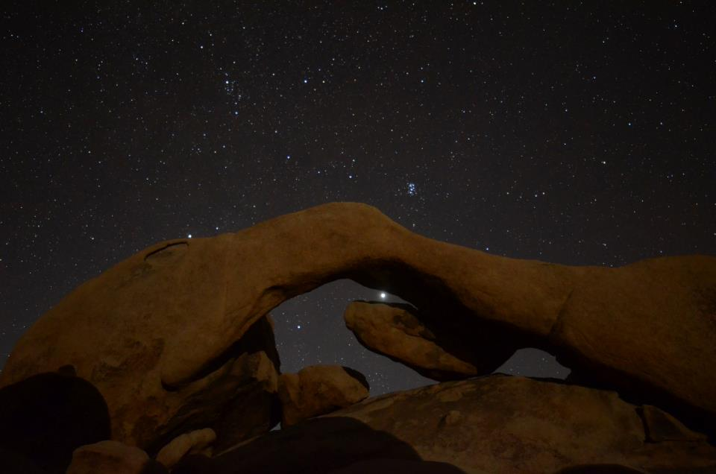
“Making fantastic imagery is infinitely more about using your brain and creativity than it is about the tools and equipment you have at your disposal.” –
adventure photographer Corey Rich

